Slide 1

Safe Care for
Michigan Kids
School Health partners

Slide 2
Objectives
To communicate the significance of student health
To create awareness of the School Health Partners
To demonstrate the benefit of School Health Partners to students with chronic health conditions, i.e. Asthma

Slide 3
Student Health? Why All The Fuss?

Slide 4

Why student health matters
High-quality health services can make a critical difference between success or failure in students
Notes:
Students come to school with more than backpacks full of homework. I am reminded of a drawing that I have in my files. It is a child at the doorstep of the school. He has multiple suitcases and bags that he is struggling to carry. Each of the totes is labeled with some sort of health challenge; asthma, hunger, bullied, cavities hurt, the list goes on and on. The principal is standing in the hallway. And the student is asking, ‘can I get a little help here?’
Without help, these challenges can lead to academic failure.
Michigan currently has a number of efforts focusing on student health. Lets take a look at them

Slide 5
Why student health matters
When children are feeling well and are stress free:
        They are better prepared to learn;
        Absenteeism is reduced;
        Achievement improves; and
        Good lifelong learning habits are developed.
Notes:
Research shows that students who are healthy perform better in school. Health includes physical and mental health. This also includes dental health.

Slide 6
Why is school attendance so important?
Students who are chronically absent form school are more likely to:
  fall behind academically
  display behavior and discipline problems
  engage in smoking, drug use, and high risk sexual behaviors
  drop out of school
Children from low-income families and communities of color and those with disabilities are at significantly higher risk
Notes:
Students who are chronically absent form school are more likely to:
fall behind academically, sometimes permanently, display behavior and discipline problems, leading to suspension and expulsion
engage in smoking, drug use, and high risk sexual behaviors
drop out of school

Slide 7
Every Child Deserves A Healthy Learning Environment
Academic achievement suffers when kids aren’t healthy
High quality health services offer the critical difference between success and failure in school.
When children are feeling well and stress free, they are better prepared to learn.
  Absenteeism is reduced, achievement improves, and good life long learning habits are developed.

Slide 8

Michigan's School Health Partners are here to help!
Coordinated School Health
School Nursing Services
School Based Health Centers
Notes:
We know in a classroom of 30 students, 3 will have asthma. A classroom is an easy place for those students to get lost in the crowd. Teachers have more and more put on their plate, they have less and less time or training to look out for the health and well-being of their students. With the guidance from MDE and MDHHS there are a number of entities that comprise the Coordinated School Health or Whole Child effort. The CDC has identified 10 areas that contribute to the health and ultimately success of students. School Health Services is one of those areas. Others include school nutrition services, health education and physical education.
Three statewide entities contribute to health services in our schools. These entities are working together to address student health, by providing care, services and health education. Lets take a look at the three School Health Partners.

Slide 9
Michigan School Health Partners
  One singular focus: the health and success of each and every child
  Focus
    Prevention
    Intervention
    Management
  Support an effective foundation for learning and achievement
Notes:
Collaborating around one singular focus: the health and success of each and every child
Focusing primarily on prevention, intervention and management, from first aid to social welfare referrals
Working to ensure student’s physical health needs are met, school health partners support an effective foundation for learning and achievement

Slide 10

Schools with School Health Partner Services and programs have:
  Fewer absences
  A decreased dropout rate
  Higher test scores
Notes:
Research shows that students are better able to achieve when they have access to a school nurse.

Slide 11



Positive Outcomes with School Health Partners
When students are kept in school, parents are able to be productive at work and at home
Appropriate use of health care saves time and money for everyone
Fewer 911 calls and appropriate referrals are made
Notes:
When our students are healthy, in school and ready to learn, parents are able to be productive.

Slide 12


Coordinated School Health
Notes:
The first of these is the School Health Coordinators

Slide 13


Michigan School Health Coordinators
Leadership and guidance
Health policies, practices, and program expertise including:
    Curriculum
    Instruction
    Assessment
Notes:
We look to our SHC for leadership and guidance in regards to health policies, practices, and program expertise. The 22 regional coordinators provide training and support for the Michigan Model for Health through 24 sites. They also provide assessment of the health curriculum and programming in schools.

Slide 14

School Nurses
Notes:
School nurses represent the 2nd School Health Partners. MASN is the statewide school nurse org.

Slide 15
School Nurses
Offer entire school population access to health services
Provide on-site intervention with actual and potential health problems
Conduct case management
services for students and families
Facilitate collaboration between
student and family to build
capacity for;
    Adaptation
    Self-management
    Self-advocacy
    Learning
Notes:
School nurses practice is a form of public health. The school nurse provides service to the entire school community; students, teachers, staff and often times family members of each. The care coordination provided by school nurses provides a link between the primary care provider and the school staff responsible for caring for the students who require care. The school nurse focuses on goal that will keep the student healthy, in school and ready to learn. This includes being able to control their condition.

Slide 16
Nurses Help Coordinate Care!
Outreach
Access to providers
Ensure students feel safe
Provide support
Encourage utilization of reporting systems
Conduct parent/caregiver and student classes
Advocate
Notes:
There is a great deal of care coordination that needs to occur to keep our students with asthma safe and in school. This care is often disregarded if a nurse is not present to provide it. School Nurses
Outreach to students/families to meet their individual needs;
Access to needed physical or mental healthcare providers;
Ensure students feel safe at school;
Provide support during the school day;
Encourage utilization of reporting systems for better data collection;
Conduct parent/caregiver and student classes on health topics;
Advocate for a school-wide approach to addressing chronic absenteeism
School nurses identify health issues before they become a medical emergency. School nurses also focus on ensuring that all students have a medical home.

Slide 17
School Nurse impact on attendance
A School Nurse is less likely to dismiss a student early than unlicensed personnel
95% students who go see a school nurse can go back to class
Play a significant role in managing chronic disease.
  School district in Dallas, Texas, where 90 percent of schools have a full-time nurse, showed no difference in attendance between asthmatic and non-asthmatic students

Slide 18
A School Nurse for Every School!
  The American Academy of Pediatrics and the National Association of School Nurses recommends 1 school nurse for every 750 students.

Slide 19
School Nurse Trivia
Can anyone guess Michigan’s School Nurse to Student Ratio?
  1:6607
  Sadly the worst in the country!

Slide 20
Notes:
Here is a breakdown by county of where the school nurses are in Michigan. You can see that we have large regions of our state with no school nurses. The only county that shows the recommended ratio actually has fewer that 750 students in the entire county.

Slide 21
School nurses save time and money
$2.20:1
Every dollar spent on nursing services, according to a recent study, saves $2.20 in medical costs and lost productivity from teachers and parents.
Notes:
Research also shows that nurses save money and time.

Slide 22
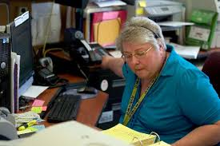
School Nurses Save Time!
For Principals, Teachers and Staff!
A school nurse in the building can save:
Principals--1 hour a day!
Teachers-- 20 minutes a day!
Clerical staff--more than
45 minutes a day!
Notes:
A school nurse in the building saves a considerable amount of time that they would have spent addressing health concerns of students.
Baisch, M.J., Lundeen, S.P., & Murphy, M.K. (2011). Evidence-based research on the value of school nurse in an urban
school system. Journal of School Health, 81(2), 74-80. Retrieved from
http://onlinelibrary.wiley.com/doi/10.1111/j.1746-1561.2010.00563.x/abstract

Slide 23

School Based Health Centers

Slide 24
In Partnership
SCHA-MI
MDHHS-CAHC Program
Professional development
Billing technical assistance and support
Communications infrastructure
Outreach
Legislative advocacy
Voice for school-based health
Annual Conference, which includes CE credits
Public Relations
Monitors and acts on national and state policy
CAHC Grant Funding
CAHC Grant monitoring
Technical Assistance
Training
SBHC assigned Consultants
Data Collection
Continuous Quality Improvement
Reporting Tools
Tool kits
Research
Site Evaluations
Coordinator’s meeting

Slide 25

Michigan’s School-Based Health Centers
Offer a full range of age appropriate health care services
  Preventive care
  Treatment of acute and co-management of chronic disease
  Immunizations
  health education and risk reduction
  mental health care
  vision and hearing
  Medicaid outreach and enrollment
  and much more

Slide 26
Michigan’s School-Based Health Centers
Provide a comprehensive spectrum of health care services to Michigan’s medically underserved school aged children and youth
Make up the second largest state-funded school-based health center program in the country
  Child & Adolescent Health Center Program
Receive more than $3 in matching funds for every $1 in State funding.

Slide 27
Student Benefit from SBHCs
Decreased engagement in risk behaviors
Fewer threats to achievement
Fewer negative peer influences
Greater self esteem and satisfaction with health
Increased physical activity
Better nutritional choices
More family involvement
Improved problem solving and conflict management
Improved health and health behaviors
CAHC 2014 Dashboard

Slide 28
Most common reasons for visits to MI SBHCs
Most frequent primary care visit
  Well Child exam: 58% of MI SBHCs (36 of 62 centers that replied to survey)
Most frequent medical problem diagnosis
  Headache 21%
  Obesity/Overweight 19%
  Asthma 17%
Most frequent mental health diagnosis
  35% adjustment disorders
  18% depressive disorders
              CAHC 2014 Dashboard

Slide 29
SBHC Impact on Attendance and Academics
Students not enrolled in an SBHC are significantly more likely to be sent home.
  “SBHCs may both indirectly support academic outcomes by maintaining the physical and emotional health of students and directly improve academic outcomes by decreasing rates of early dismissal, which increases the time a student is available in the academic setting to learn.” (Cura, 2010)

Slide 31
A school nurse and SBHC in the same school?
Roles are complementary with a shared mission
SBHCs do not take the place of a school nurse
Collaboration between the two leads to enhanced student health, academic outcomes, life long achievement and overall student and staff well-being
School Nurse + School-Based Health Center =Student Success!!!!

Slide 33
Managing Chronic Disease (Asthma case study)
What role can School Health Partners Play?

Slide 34
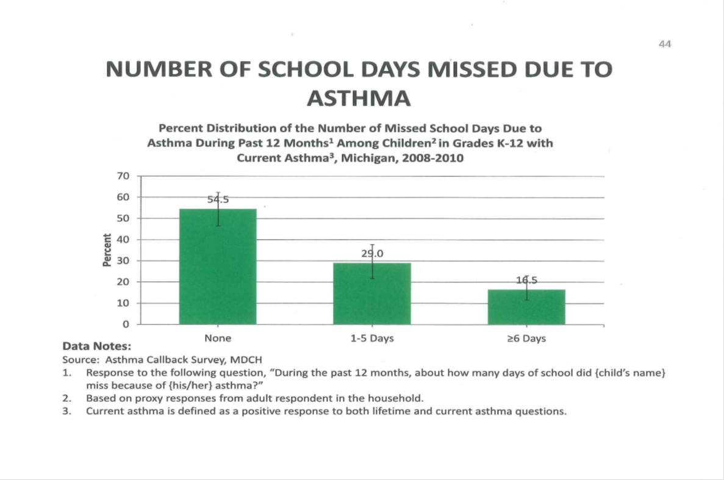
School Days Missed
Notes:
Take asthma for example. Asthma is the leading cause of student absence nationwide, contributing to over 10 million missed school days per year. The Michigan asthma callback survey collects data about children that are released from the ED after an asthma episode. It has provided data showing a high number of school days missed due to asthma. When these students are out of school due to asthma symptoms or missing multiple days of school, they fall further and further behind.

Slide 35
School Health Partners
Student with Asthma
Health Education
Patient care
Care Coordination
Notes:
School Health Partners can work together to ensure that our students with Asthma have everything they need to be healthy, in school and ready to learn.
Health Education provided by the health teacher who is trained in Michigan Model for Health.
Care coordination provided by the School Nurse to ensure that the parent, the school staff, the student and the primary care provider are all communicating and working together to keep the student’s asthma under control.
Primary care provided by the SBHC that is convenient to get to and ensures that the student is not away from school more than necessary.

Slide 36
Why talk about asthma?
Most common chronic disease of childhood
It can be deadly.
Number one reason for missed school days.
Most asthma episodes can be prevented.
There are legal requirements that affect how schools deal with students who have asthma.
7% of inhaler users demonstrate correct use of their device. Ann Allergy Asthma Immunol. 2015:114:74-76
Notes:
Most common chronic disease of childhood aside from dental caries.
6-10 children die every year in Michigan from Asthma many of these occur after a child has been seen in the emergency department.

Slide 37

Safe Medication Administration in School
Training provided by School Nurses
  Includes use of Spacer with Multi-dose Inhaler
  Utilizing 5-10-5 technique
Care delivered by SBHC
  Rescue and controller medication
  Asthma Action Plan
Supported by Health Teachers
  Skill based health education
Notes:
It is important that anyone with asthma uses their rescue inhaler correctly, or an asthma emergency can become deadly. Without a nurse available, there may not be anyone in the building who can ensure that students with asthma are using a spacer, and the 5-10-5 technique, which is the best way to ensure the proper dose has been delivered.
All students with asthma should have an asthma action plan on file. Especially if they are self-carrying/self-administering.

Slide 38
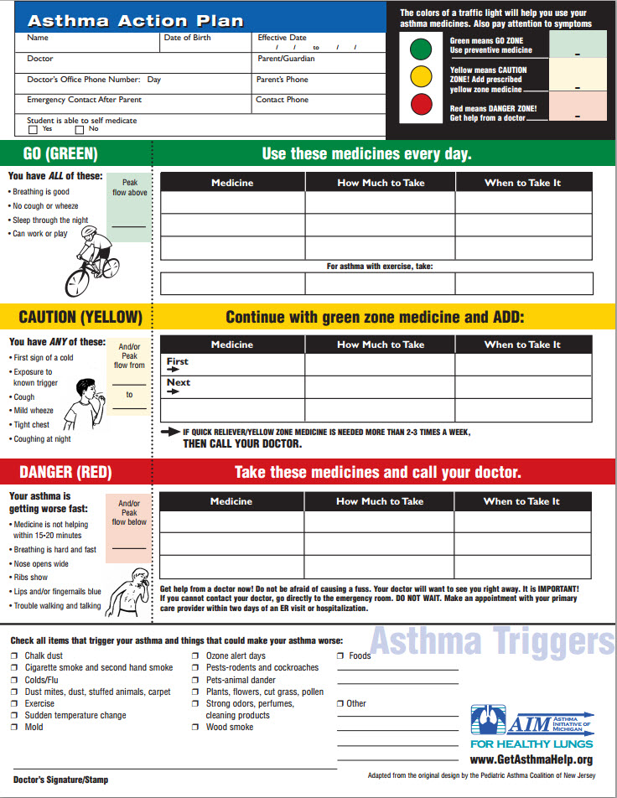
Asthma Action Plans
Sadly, most children with asthma do not have an action plan on file.
Notes:
An Asthma Management (Action) Plan will tell patients:
What medicines to take
When to take them
What to do when symptoms occur
What ones triggers are
When to seek help
The AMP zones are based on symptoms.
The AMP can be used for any age (even infants).
Plans vary in sophistication from very complex to very simple.

Slide 39
School Health Partner’s and Asthma
  Asthma care is coordinated
  Children, parents, schools and community are adequately prepared to deal with asthma
  Urgent care and ER visits are reduced
  School absence is reduced
  Parents miss less work
  Most importantly, children with asthma can lead normal activities, including play, sports, exercise, or other school activities
Notes:
Care Coordination can lead to our students with asthma having control of their asthma symptoms and the ability to succeed in school and anything else that they want to participate.

Slide 40
Beyond Asthma
SHP services also play a significant role in other health issues:
  Obesity
  Behavior problems
  Drug use
  Emotional problems
  Physical abuse
  Sexually Transmitted Disease
  Nutrition
Notes:
So we hope we have planted a small seed with you about the value of the School Health Partners.
In addition to asthma and other chronic health conditions, the School Health Partners provide support for all of the forms of ‘baggage’ students bring to school.

Slide 41

A Coordinated School Health Approach
Partners in action…

Slide 42
Support Your School Health Partners
  Parentactionforhealthykids.org
  School Nurse Awareness Campaign
    http://www.parentactionforhealthykids.org/school-nurse-awareness-campaign/
  School Community Health Alliance of MI
    http://scha-mi.org/
  Michigan Coordinated School Health Association
    http://mishca.org/

Slide 43
Questions?

Slide 44
THANK YOU!
Evilia Jankowski, MSA, BSN, RN
810-591-5144
EVILIAJANKOWSKI@GMAIL.COM
ELLIOTT ATTISHA, DO, FAAP
313-461-2504
eattish1@hfhs.org
TARYN MACK
906-482-4880
tmack@theinst.org

